Slide 1
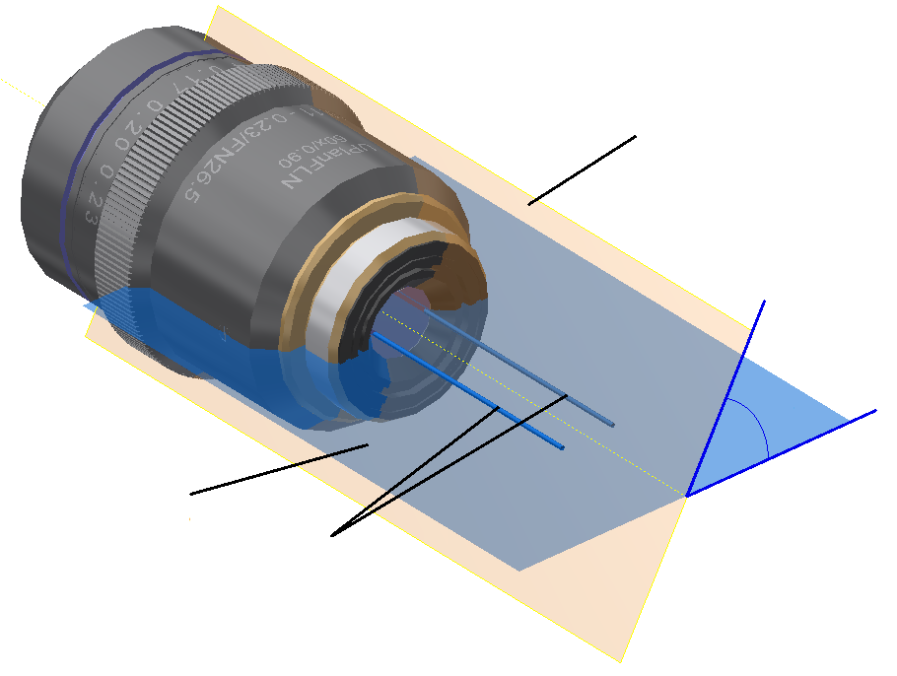
Plane at (ϴ=60°)
60°
Meridional
plane (ϴ=0°)
Lasers polarised
at ϴ=90°

